Slide 1


Giuseppe Pauselli
THE DIGESTIVE SYSTEM

Slide 2
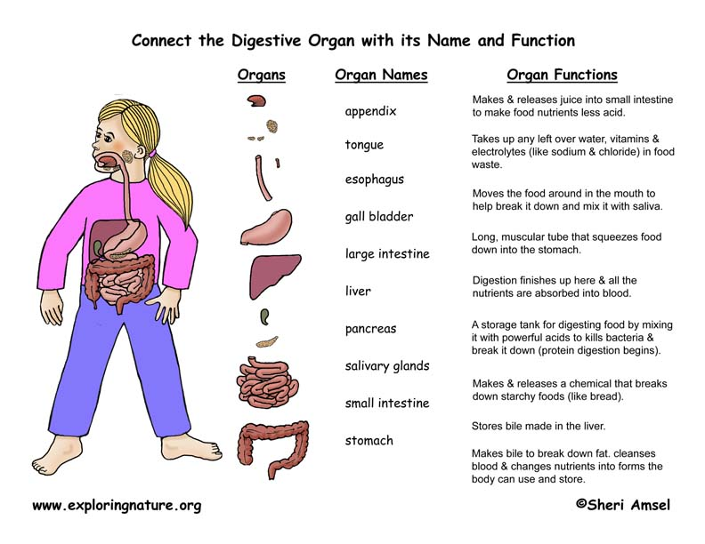
Activity 1: matching

Slide 3
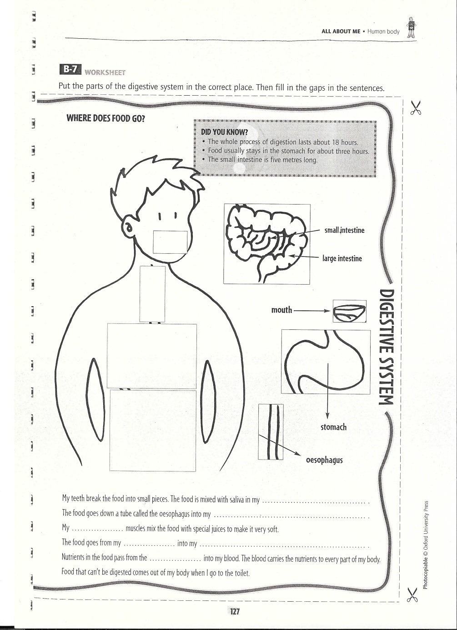
Activity 2:
Connect and fill in the gaps

Slide 4
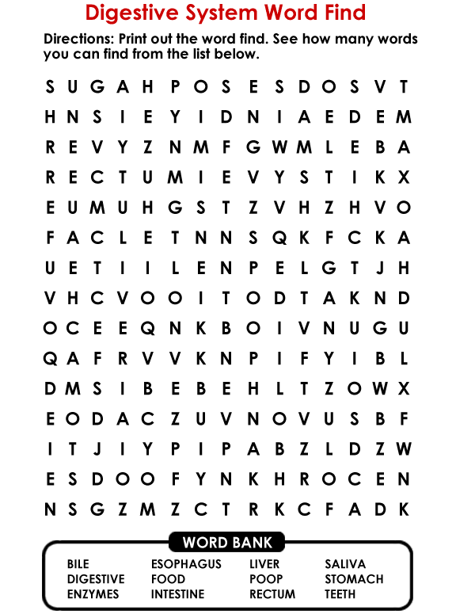
Activity 3:
Find the words

Slide 5
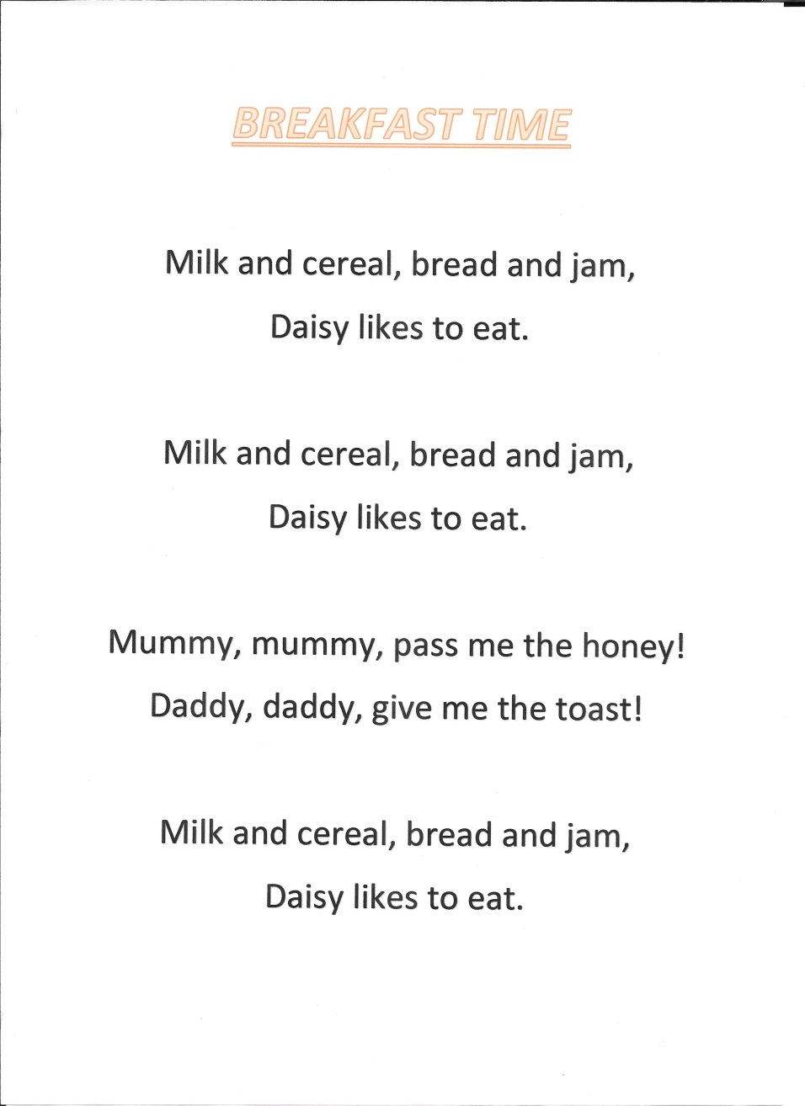
Singing a song

Slide 6
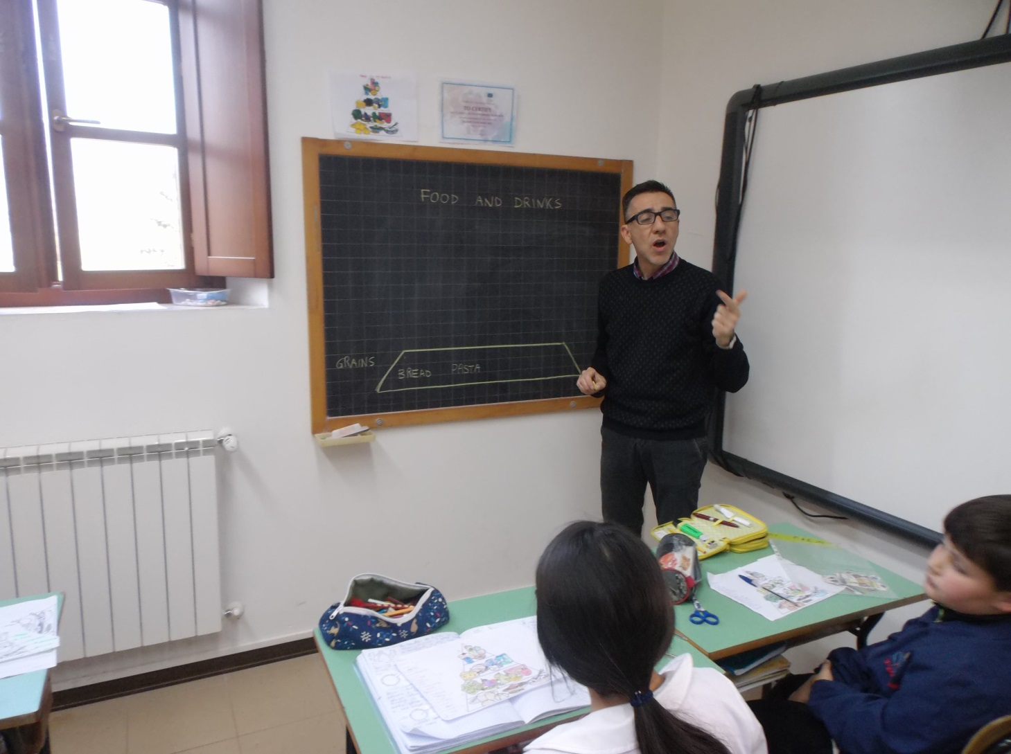
Explaining the food pyramid

Slide 7
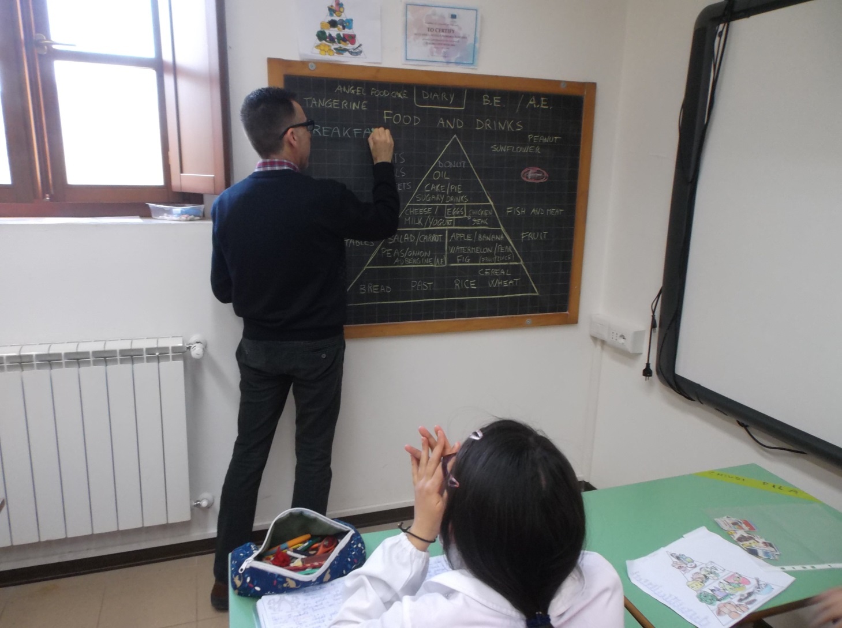
Talking about food and drinks

Slide 8
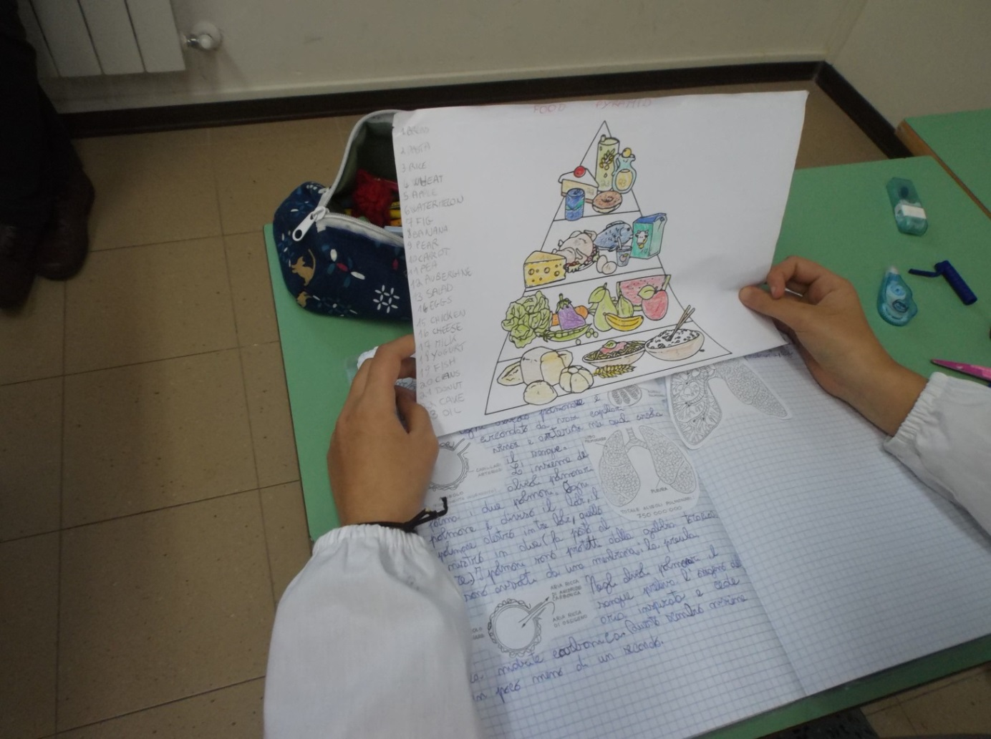
Playing with the food pyramid

Slide 9
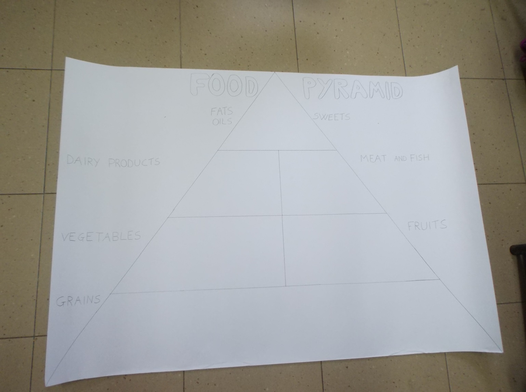
The pyramid project

Slide 10
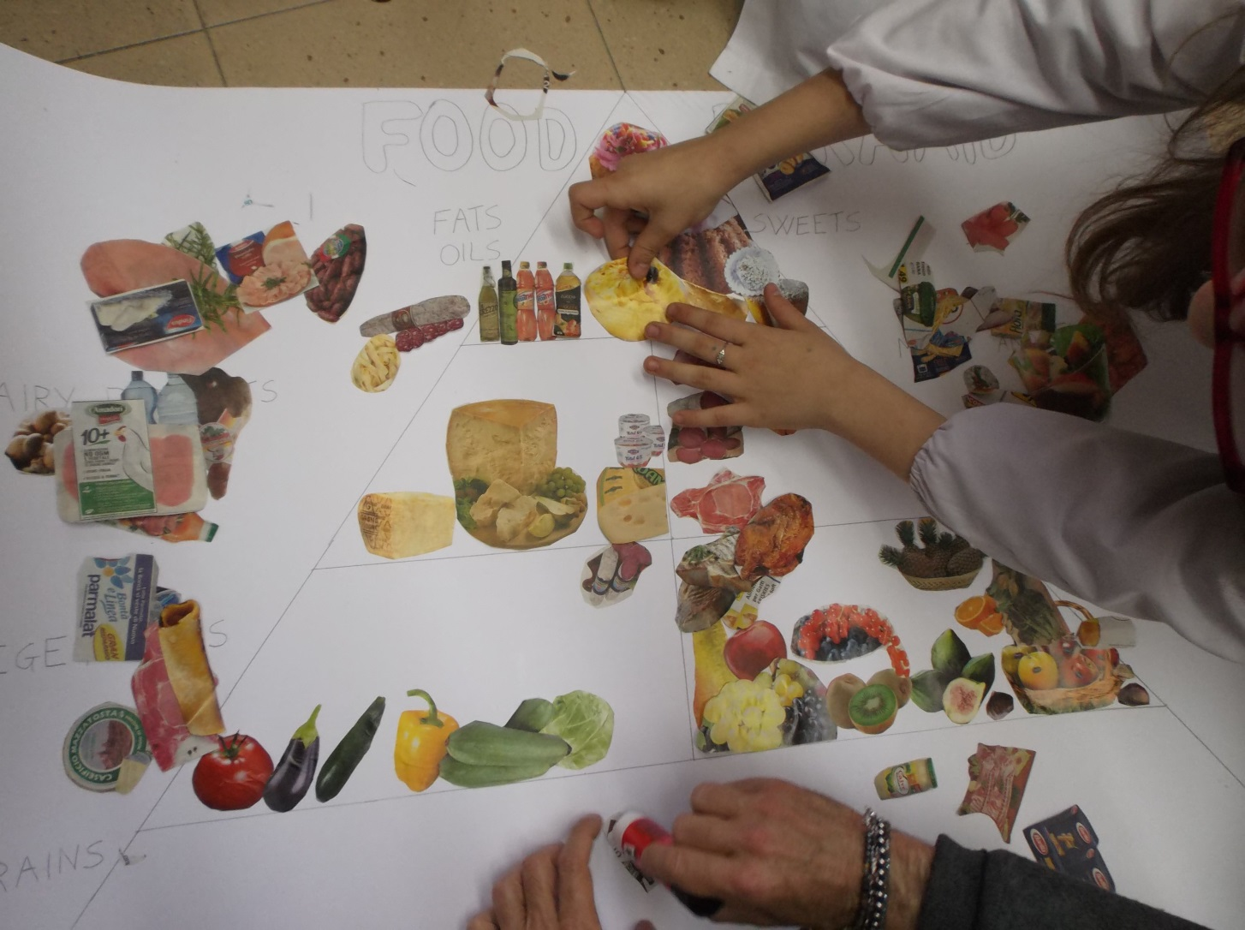
«Building» the food pyramid

Slide 11
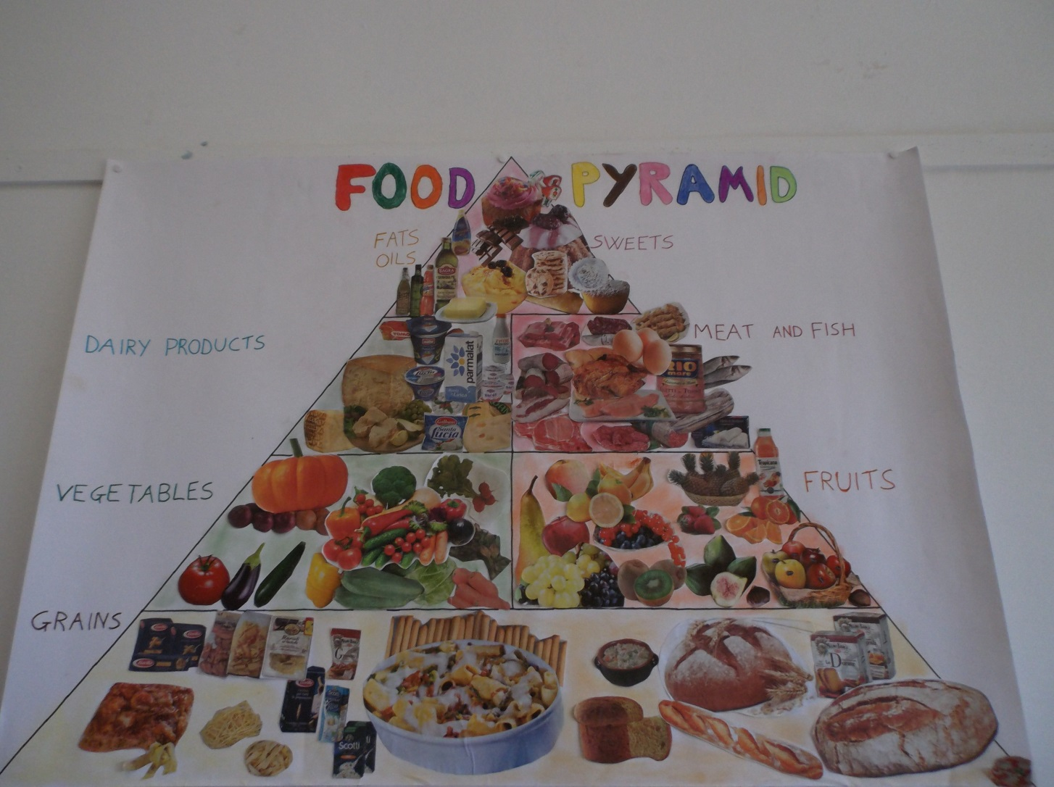
Completing the food pyramid

Slide 12
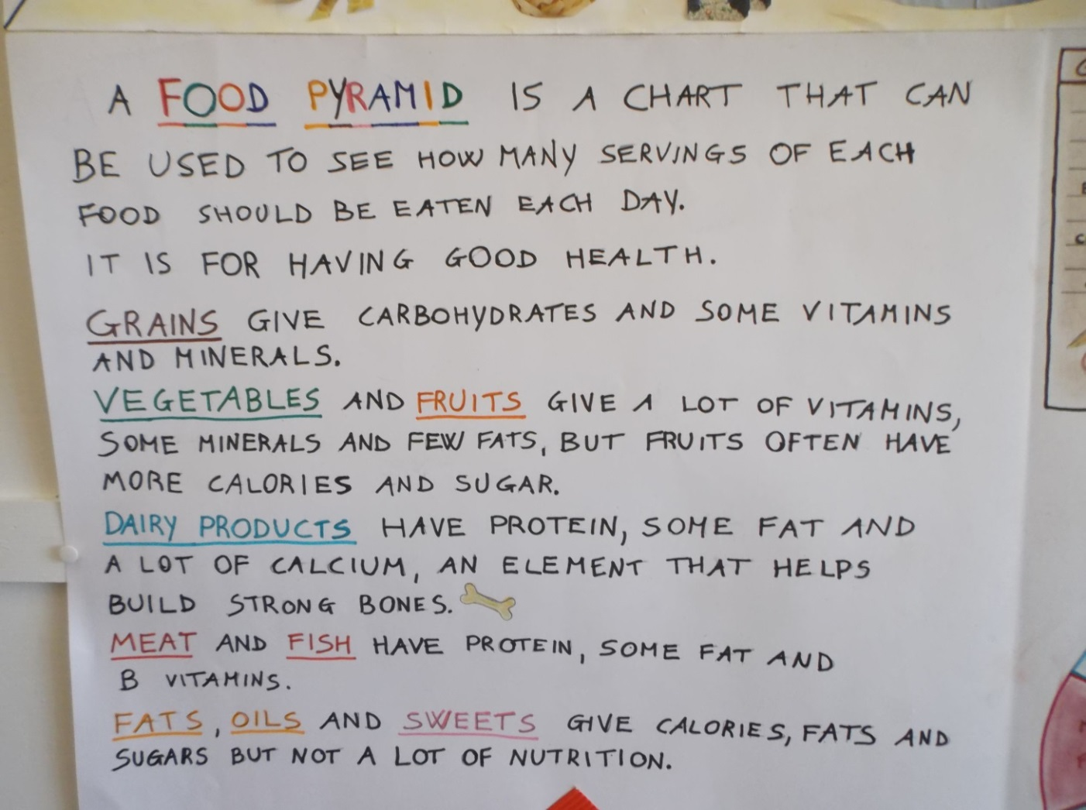
Understanding what is the real meaning of a food pyramid

Slide 13
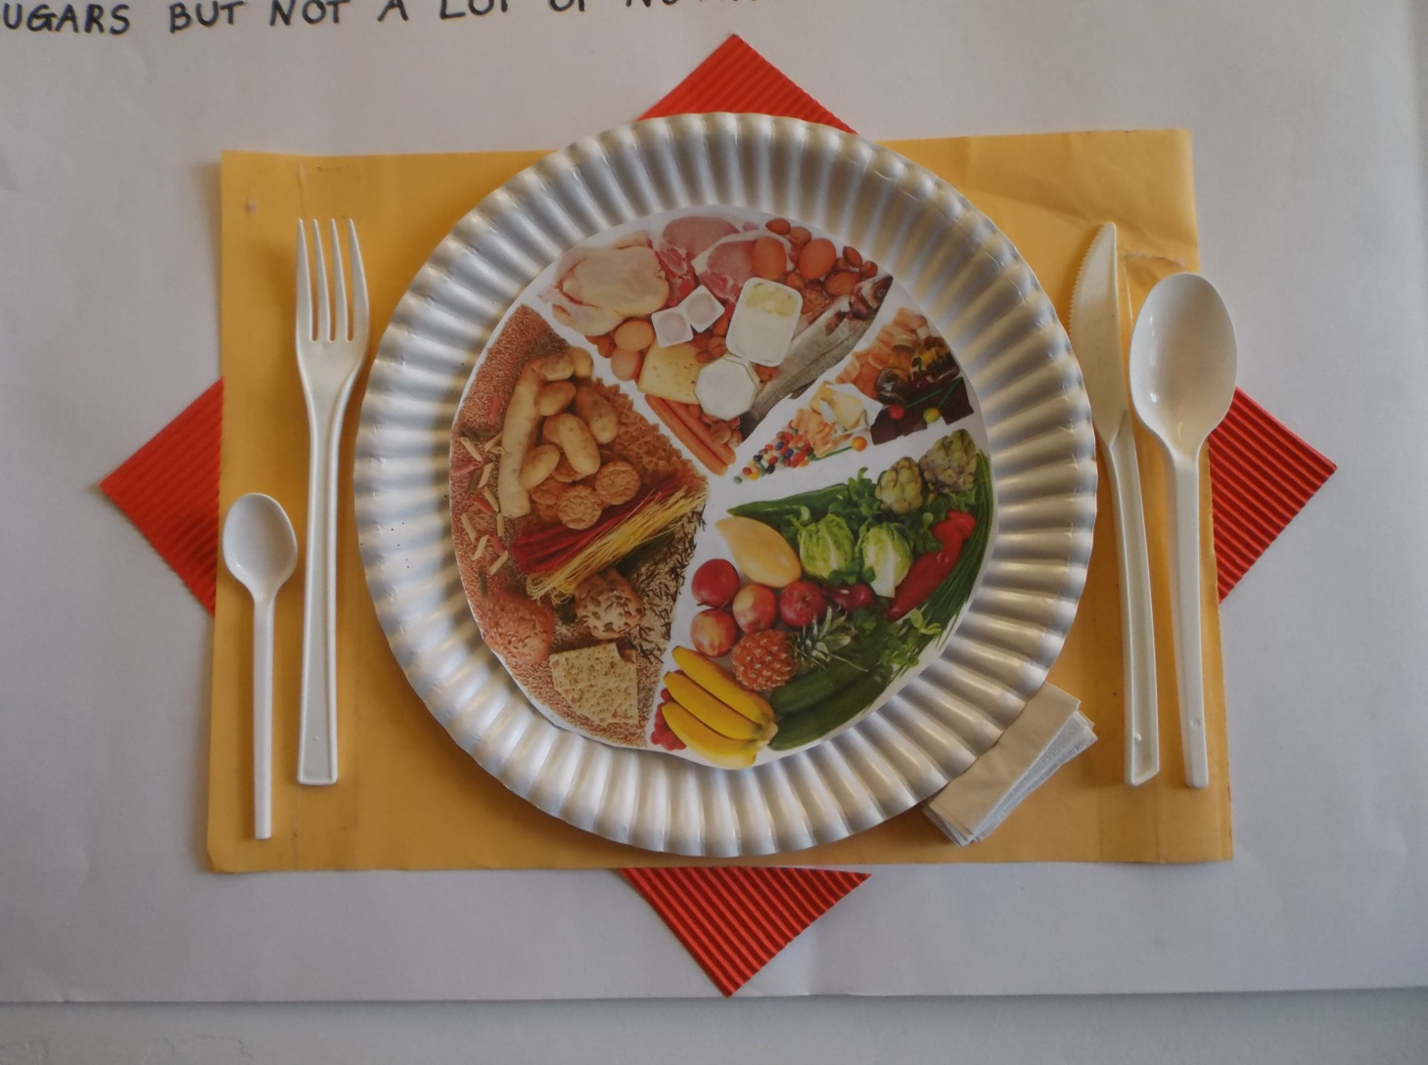
Another funny way to explain

Slide 14
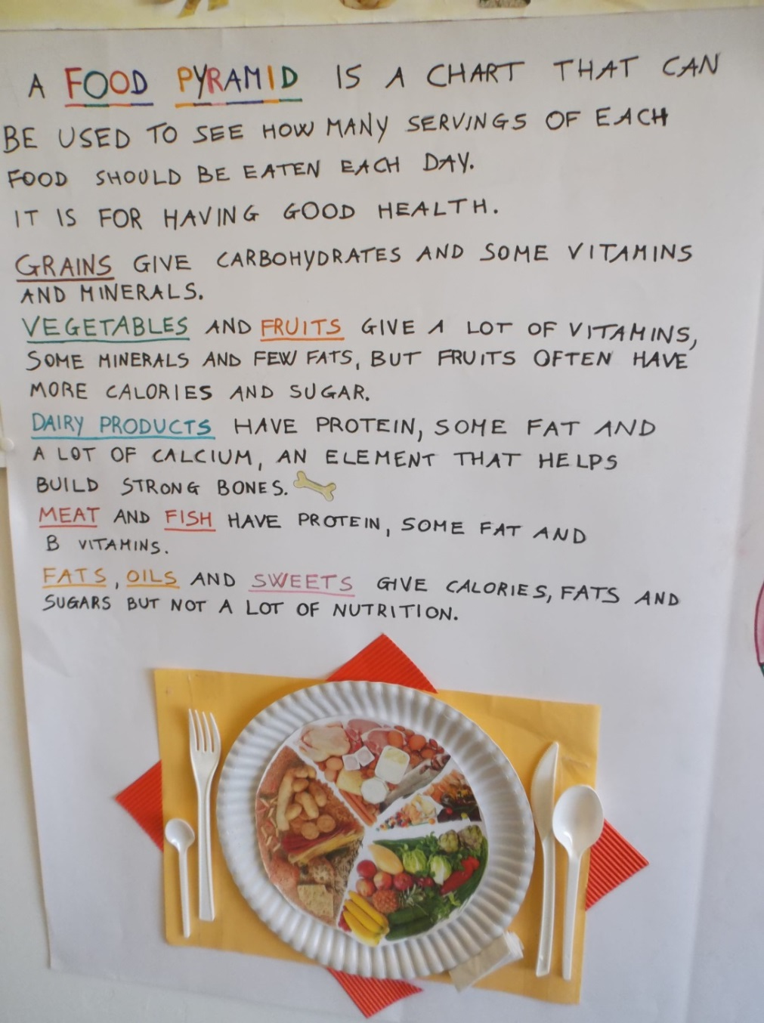
Revising the content

Slide 15
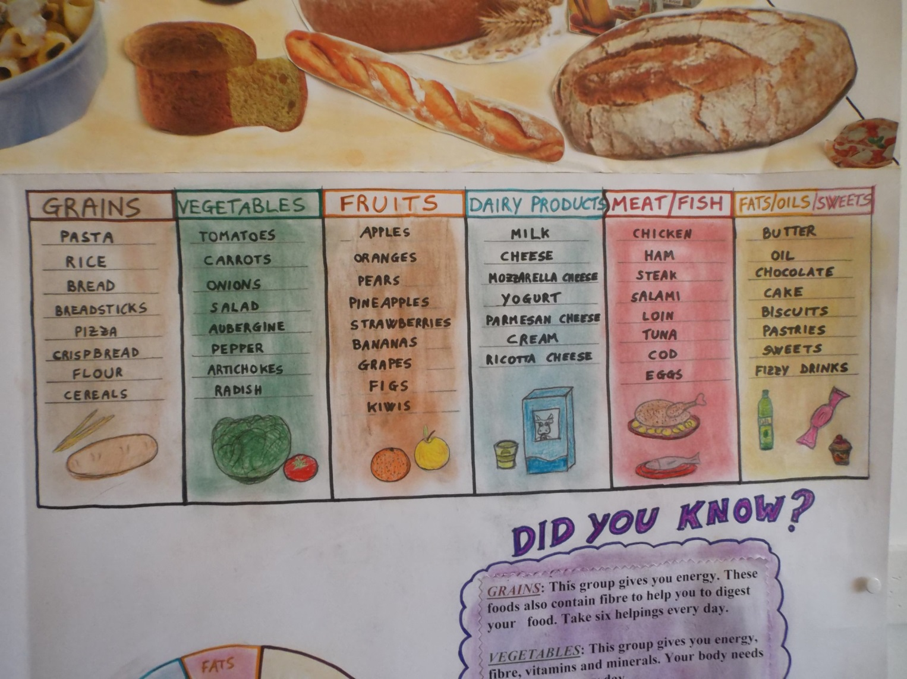
The food represented

Slide 16
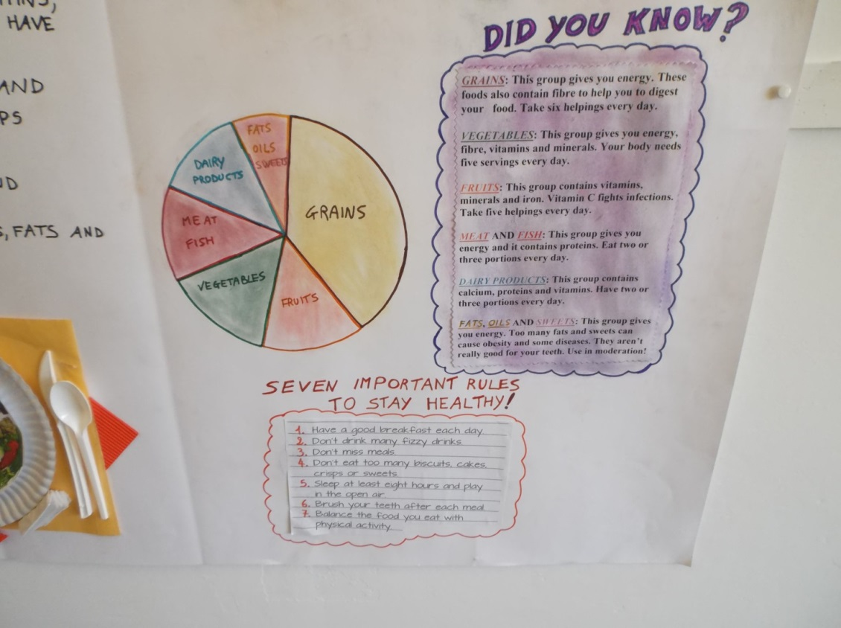
Some related activities

Slide 17
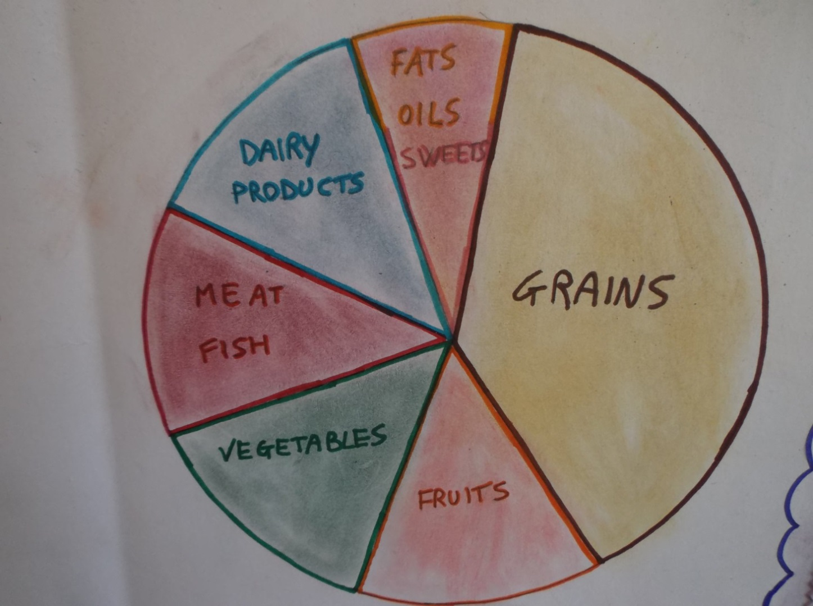
Another way to explain

Slide 18
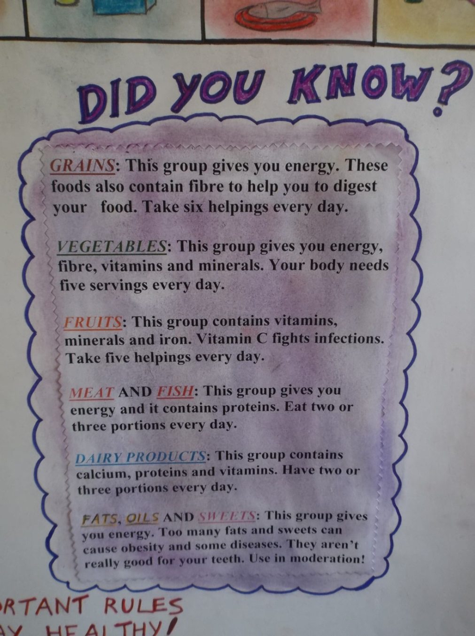
In-depth analysis

Slide 19
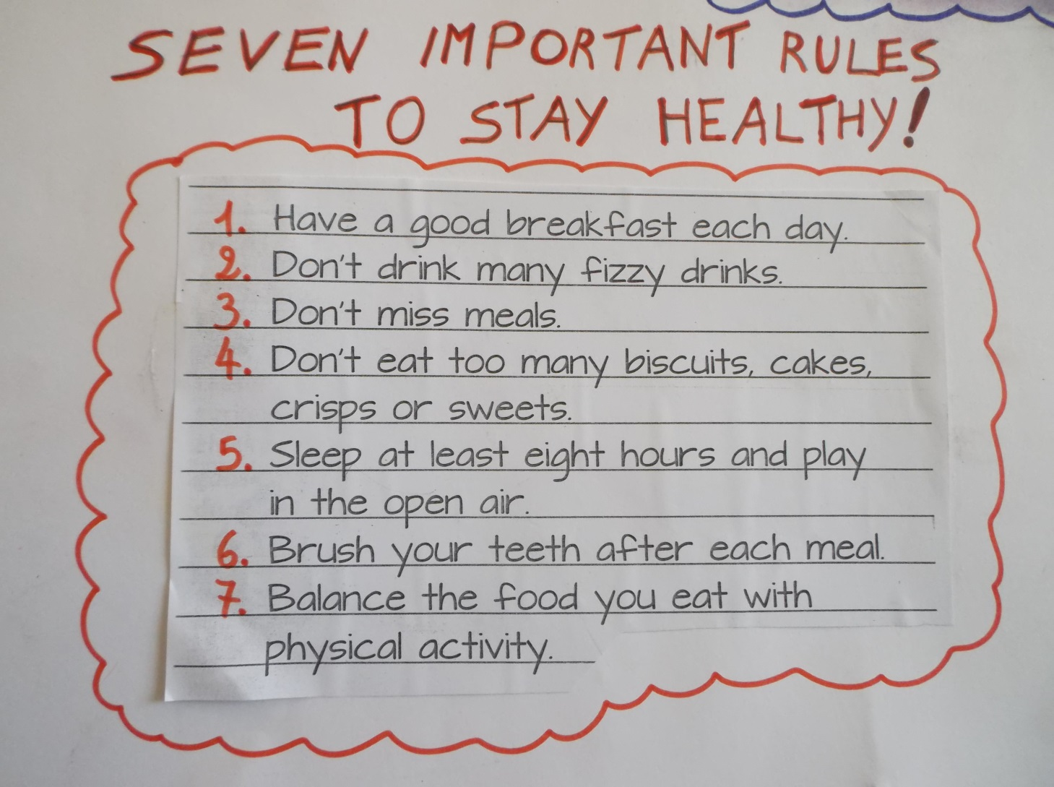
Some advice to stay healthy

Slide 20
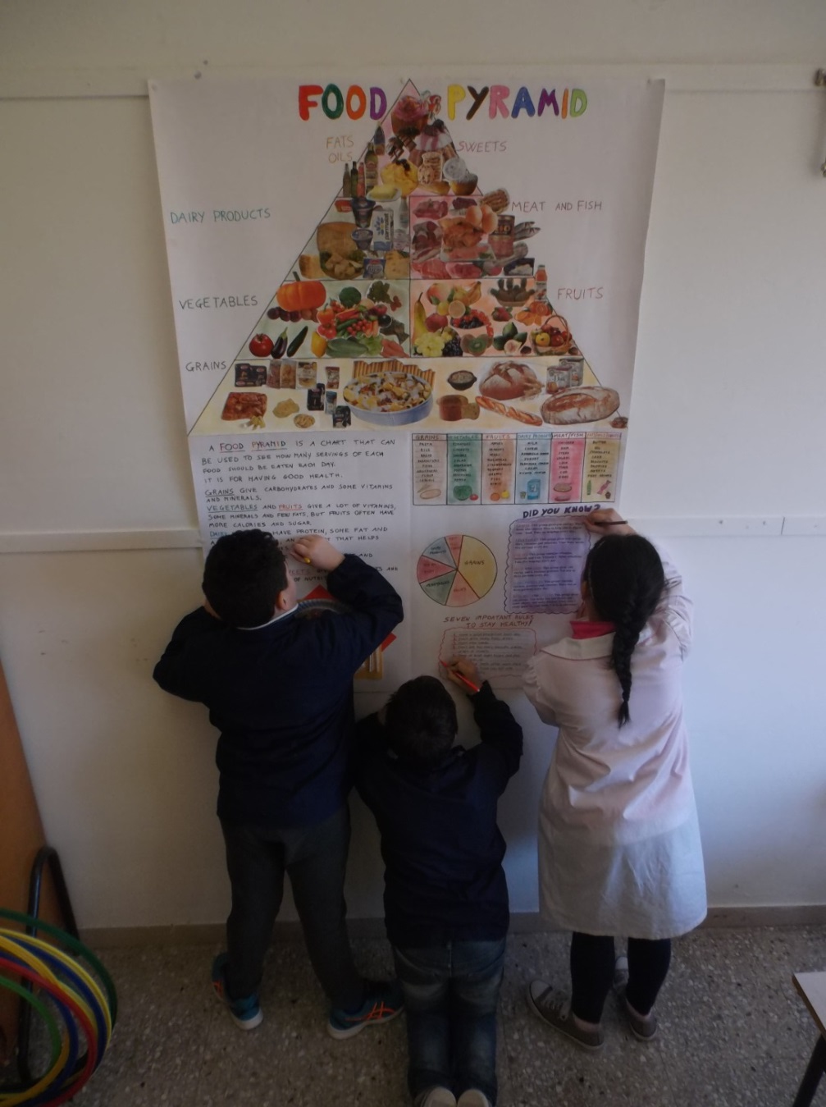
Children at work

Slide 21
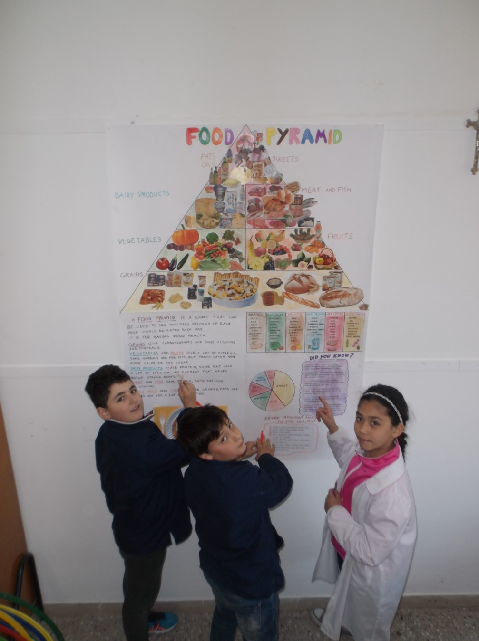
The work is ending

Slide 22
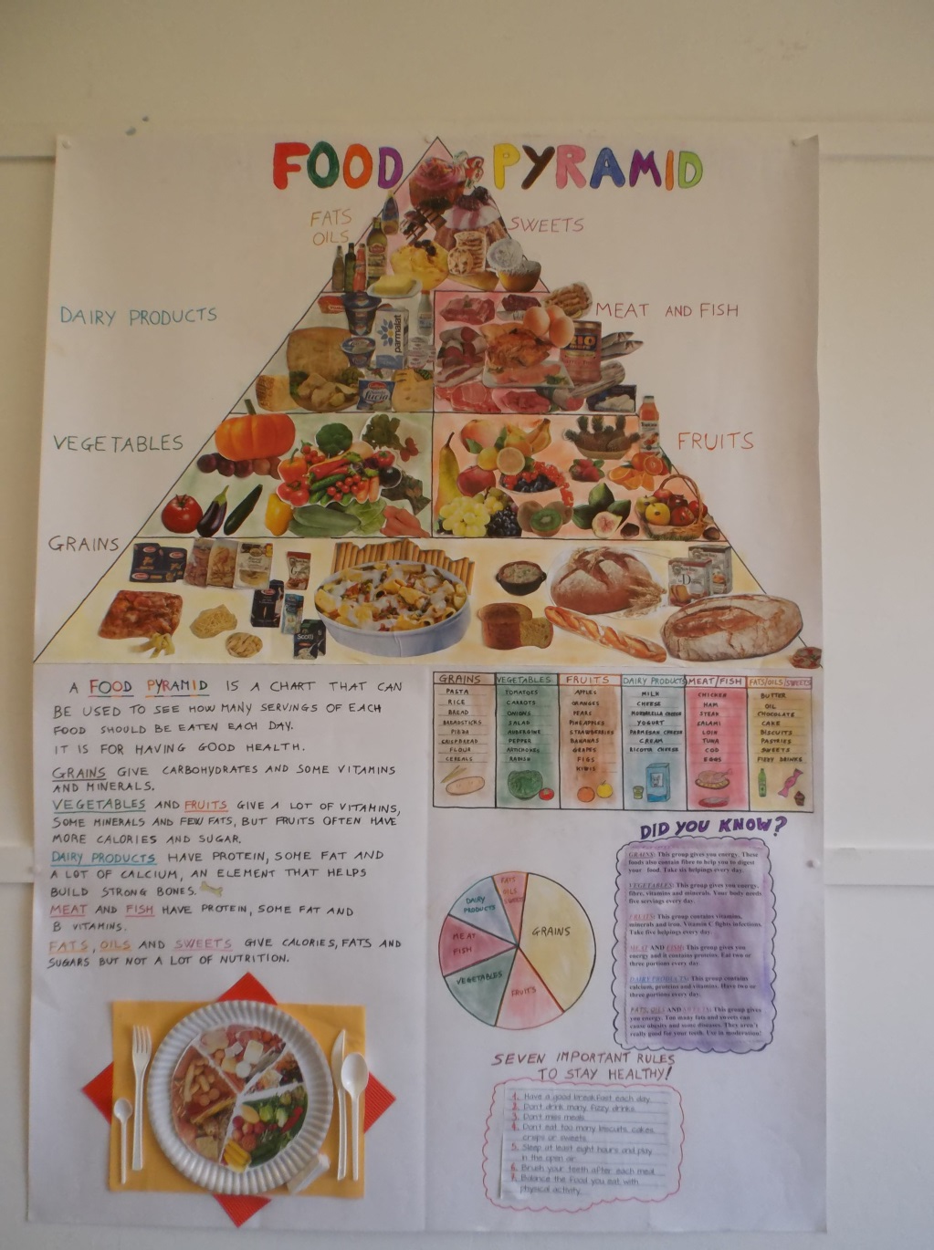
The final result

